Slide 1

GSU Data Visualization Final Project
P&C Insurance Company “ABC”
Fire Score Impact & Profitability
Chris Cirelli
10/06/2020
Notes:
The topic of this presentation is to present an argument that a hypothetical insurance company is trying to make to their reinsurance carriers
That the proprietary fire score that they have developed mitigates materially the potential that their book of business will incur a severity loss.

Slide 2
Problem Statement
ABC Insurance uses a proprietary fire-response-time-model for risk selection that contributes to an overall and relatively lower probability of incurring a severity loss.
*For purposes of the Excess of Loss (XOL) treaty, severity is defined as a loss exceeding $3.5m.

Slide 3
Contentions
Fire is likely the only type of claim that can give rise to a loss in excess of $3.5m.
Compare Key Statistics and Distributions for Fire Losses versus Other Claims.
2. There is a positive correlation between response times and fire loss severity
Inspect the relationship between the severity of ABC’s historical Fire Losses & Response Times.
3. ABC utilizes the Fire Response Times for risk selection.
Inspect declination statistics by reason and the composition of ABC’s portfolio by response time.
4. ABC’s portfolio is better than the overall market in terms of Fire Response Times
Compare the distribution of response times for similar geographical areas between the ABC’s portfolio NFIR fire response dataset.
5. ABC’s portfolio has an absolute and relative lower probability of incurring a severity loss
Fit a distribution to ABC’s historical fire losses and calculate probability of incurring a loss > $3.5m.

Slide 4
Data set
Policy Data
Source ABC Policy Data
Date Range 2014 to 2020
Total Policies 40,205
Loss Data
Source: ABC Loss Data
Date Range: 2014 to 2020
Total Claims: 2,697
Other
NFIR NFIRSPROCESSING/datasets/fireaddresses_copy/explore/
Fire Scores ABC Fire Scores

Slide 5
Fire is likely the only type of claim that can give rise to a loss in excess of $3.5m

Slide 6
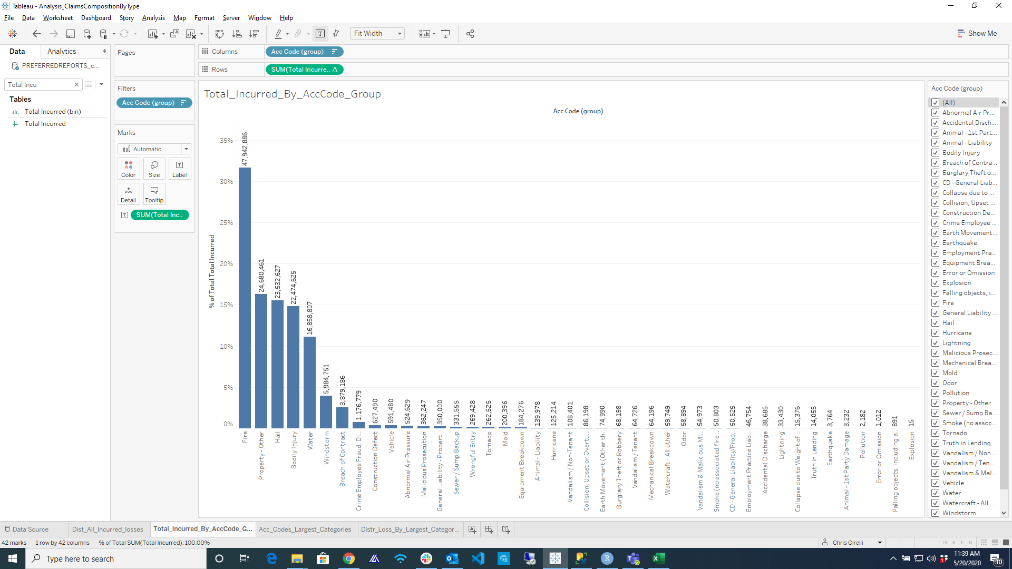
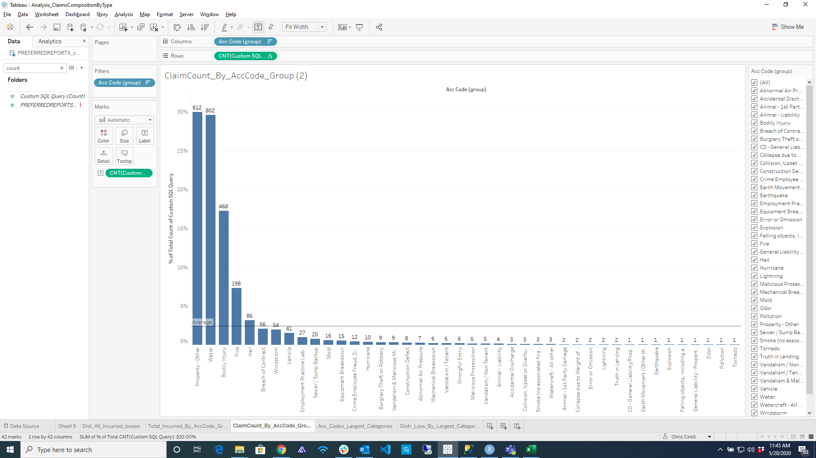
Claims
Composition
Purpose
To understand the composition of incurred losses and claims frequency by claims type.
Visualizations
The top chart represents the sum of loss incurred by loss peril.
The bottom chart represents the frequency of losses by claims type.
Observations
Fire, Property-Other, Hail, Bodily Injury and water represent over 85% of incurred loss.
These same perils represent a similar percentage of the count of claims yet with a materially different ordering.
For instance, Fire & Hail comprise close to 50% of all incurred loss yet around 15% of the frequency.
This indicates that Fire and Hail are infrequent yet severe loss occurences.

Slide 7
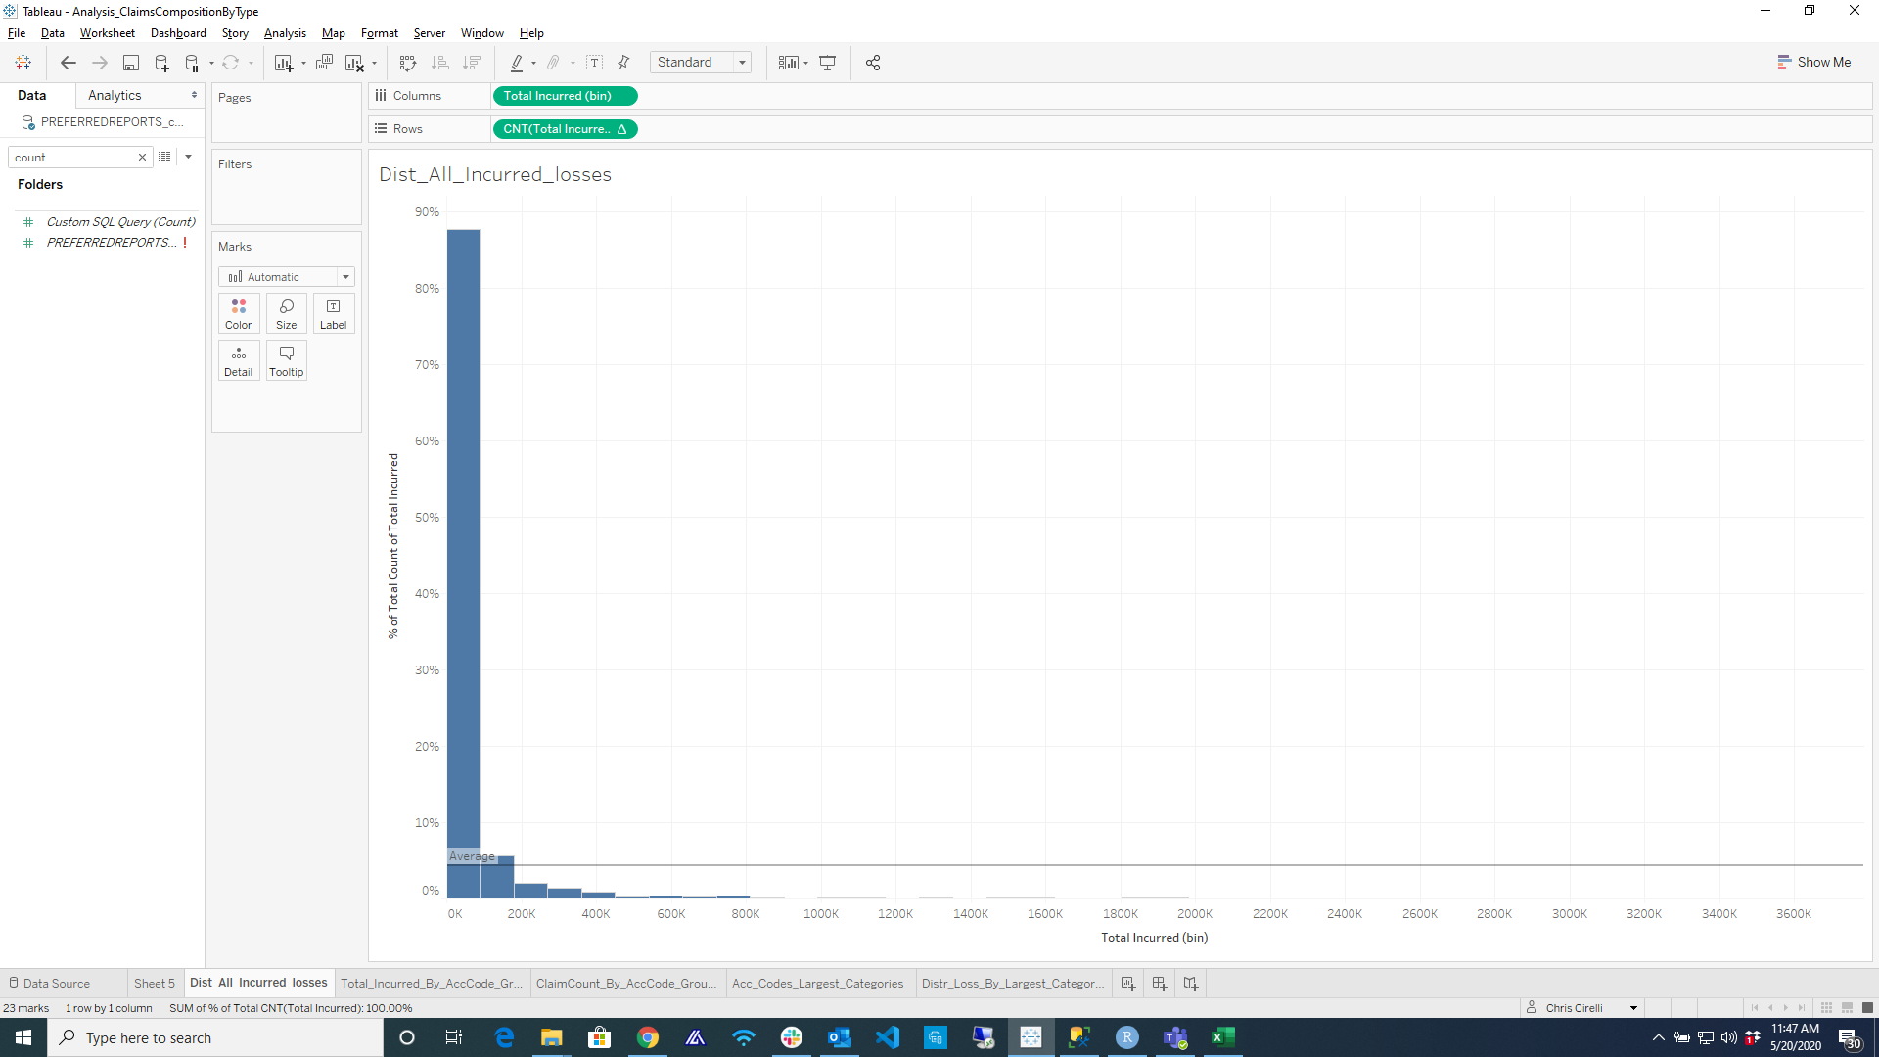
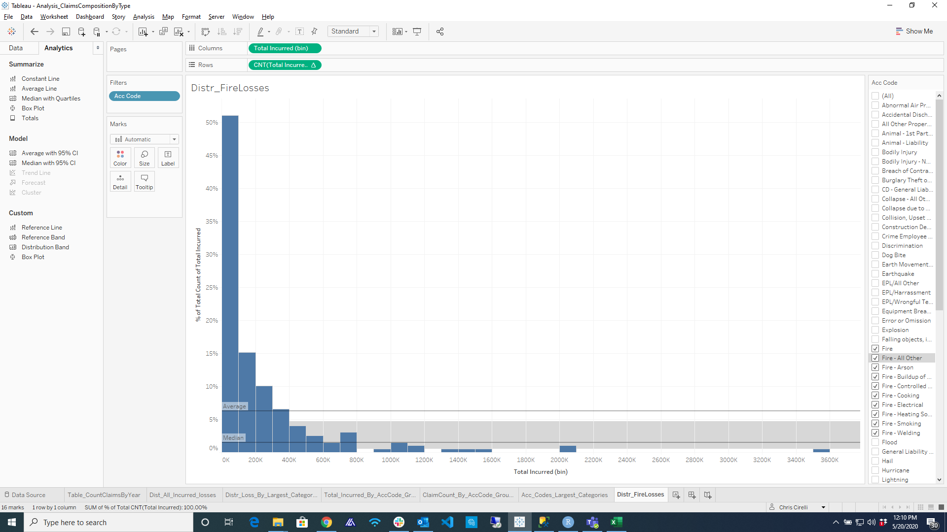
Distribution of Losses
All & By Loss Category
Purpose
To understand the distribution of incurred losses for all perils versus fire losses.
Visualizations
The first chart represents the distribution of all incurred losses.
The second chart represents the distribution of fire losses.
Observations
The losses for all perils exhibits an exponential distribution with majority of the frequency of losses occurring under 100k (88%). And 94% below 200k.
While fire losses exhibit a similar exponential distribution the tail is much fatter, with only 65% of losses falling under 100k and multiple loss occurrences in excess of $1m.
Heavier Tail

Slide 8
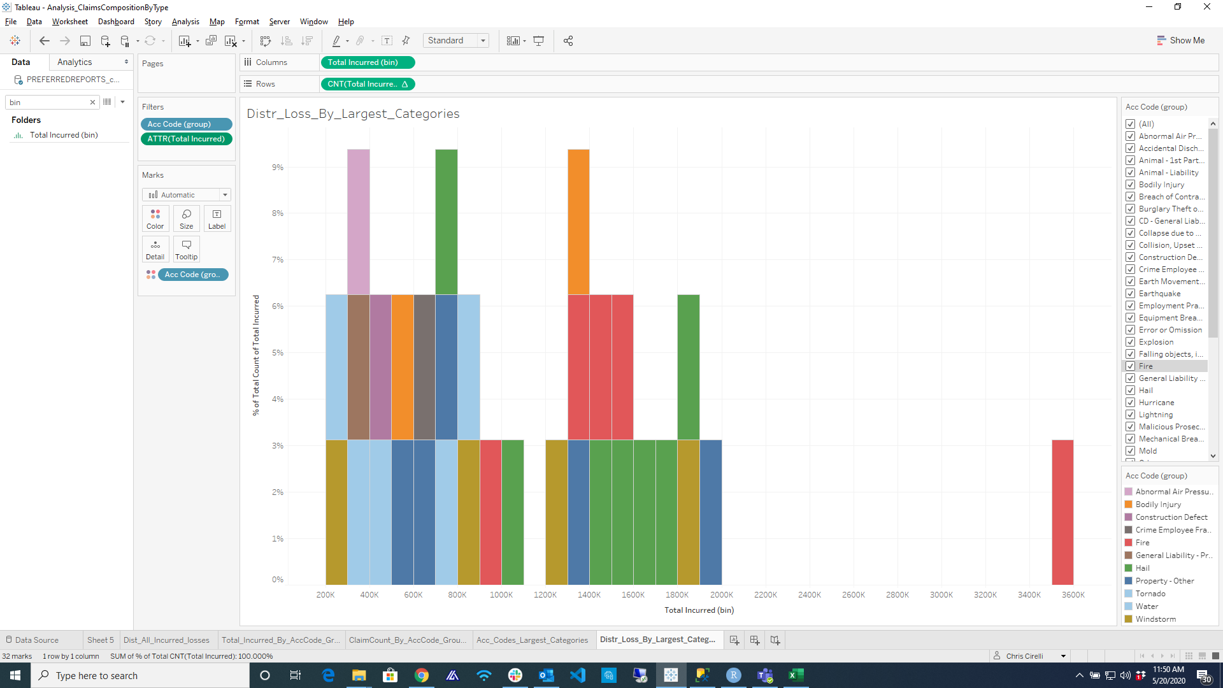
Statistics
Fire Losses
Purpose
To understand which loss peril categories have the heaviest tails as it relates to total incurred loss.
Visualizations
The graph shows the distribution of claims by peril for incurred losses > 200k. These represent 5% of all claims.
The second visual is a chart that compares measures of central tendency between Fire, Hail and All loss perils.
Observations
Both Hail and Fire losses dominate distribution of losses > 200k. In fact, Hail is more highly represented than fire in losses between 1 and 2m.
From the table at the bottom we can see that while Hail and Fire have similar average losses, Fire has a significantly larger median
Conclusion
It is likely that fire, and to a lesser extent hail, are the two loss perils that could give rise to a severity loss in excess of $3.5m.
 | Total Count | Avg Loss | Median | Largest
Fire | 225 | $235K | $90,176 | $3.5m
Hail | 86 | $273k | $39,556 | $1.95M
All | 2713 | 55k | $9,025 | $3.5M

Slide 9
There is a positive correlation between response times and fire loss severity
Notes:
There is a positive correlation between response times and the severity of a fire loss
Utilizing Swyfft’s historical fire losses, inspect the relationship between Fire Response Times & Loss Severity.

Slide 10
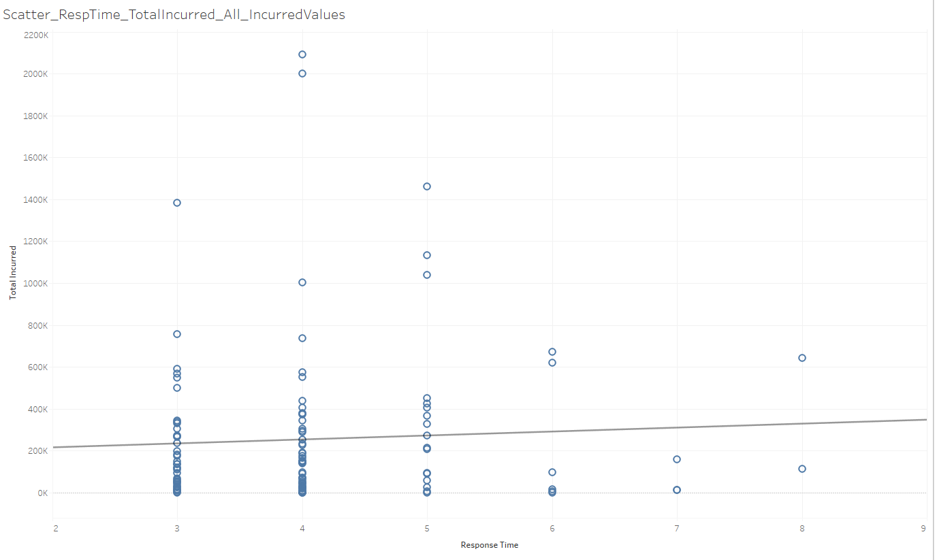
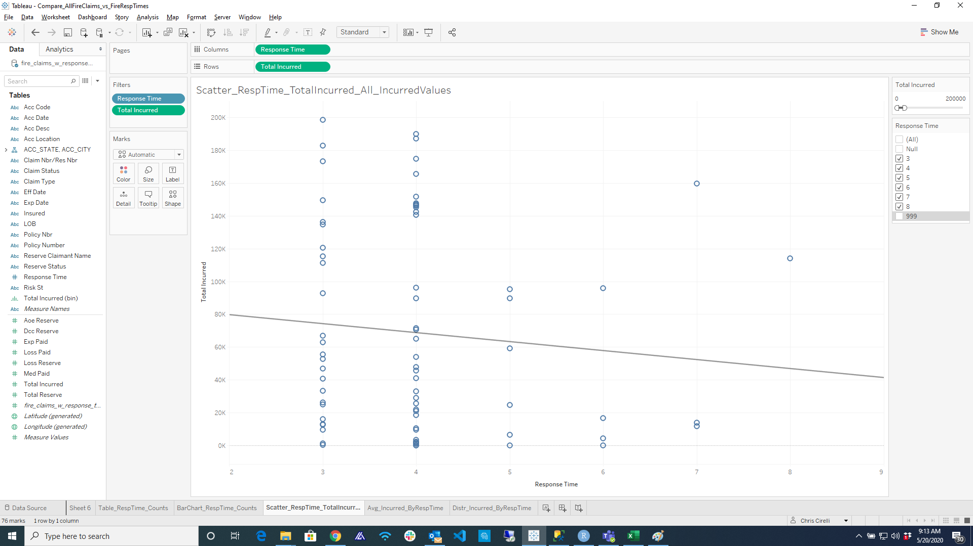
Incurred Loss
By Fire Response Times
All Incurred Values
Purpose
To determine if there is a linear relationship between incurred fire losses & fire response times.
Visualisations
The first graph shows the distribution of fire losses by response time. Each bubble represents a fire loss. The horizontal line is a regression line fit to the data.
The second graph is the exact same representation as the first, but for losses < $200k, or 80% of all fire claims.
Observations
Neither all incurred losses nor those less than 200k exhibit a strong positive correlation with response times.
Incurred values of < 200k actually exhibit a negative correlation with response times.
Incurred Values < 200k

Slide 11
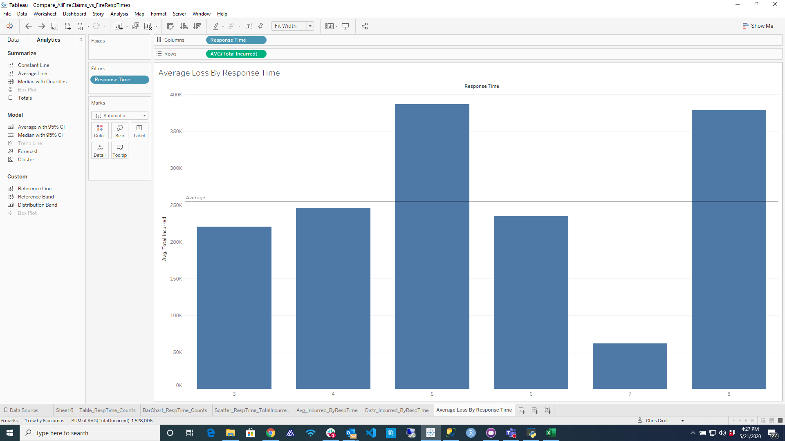
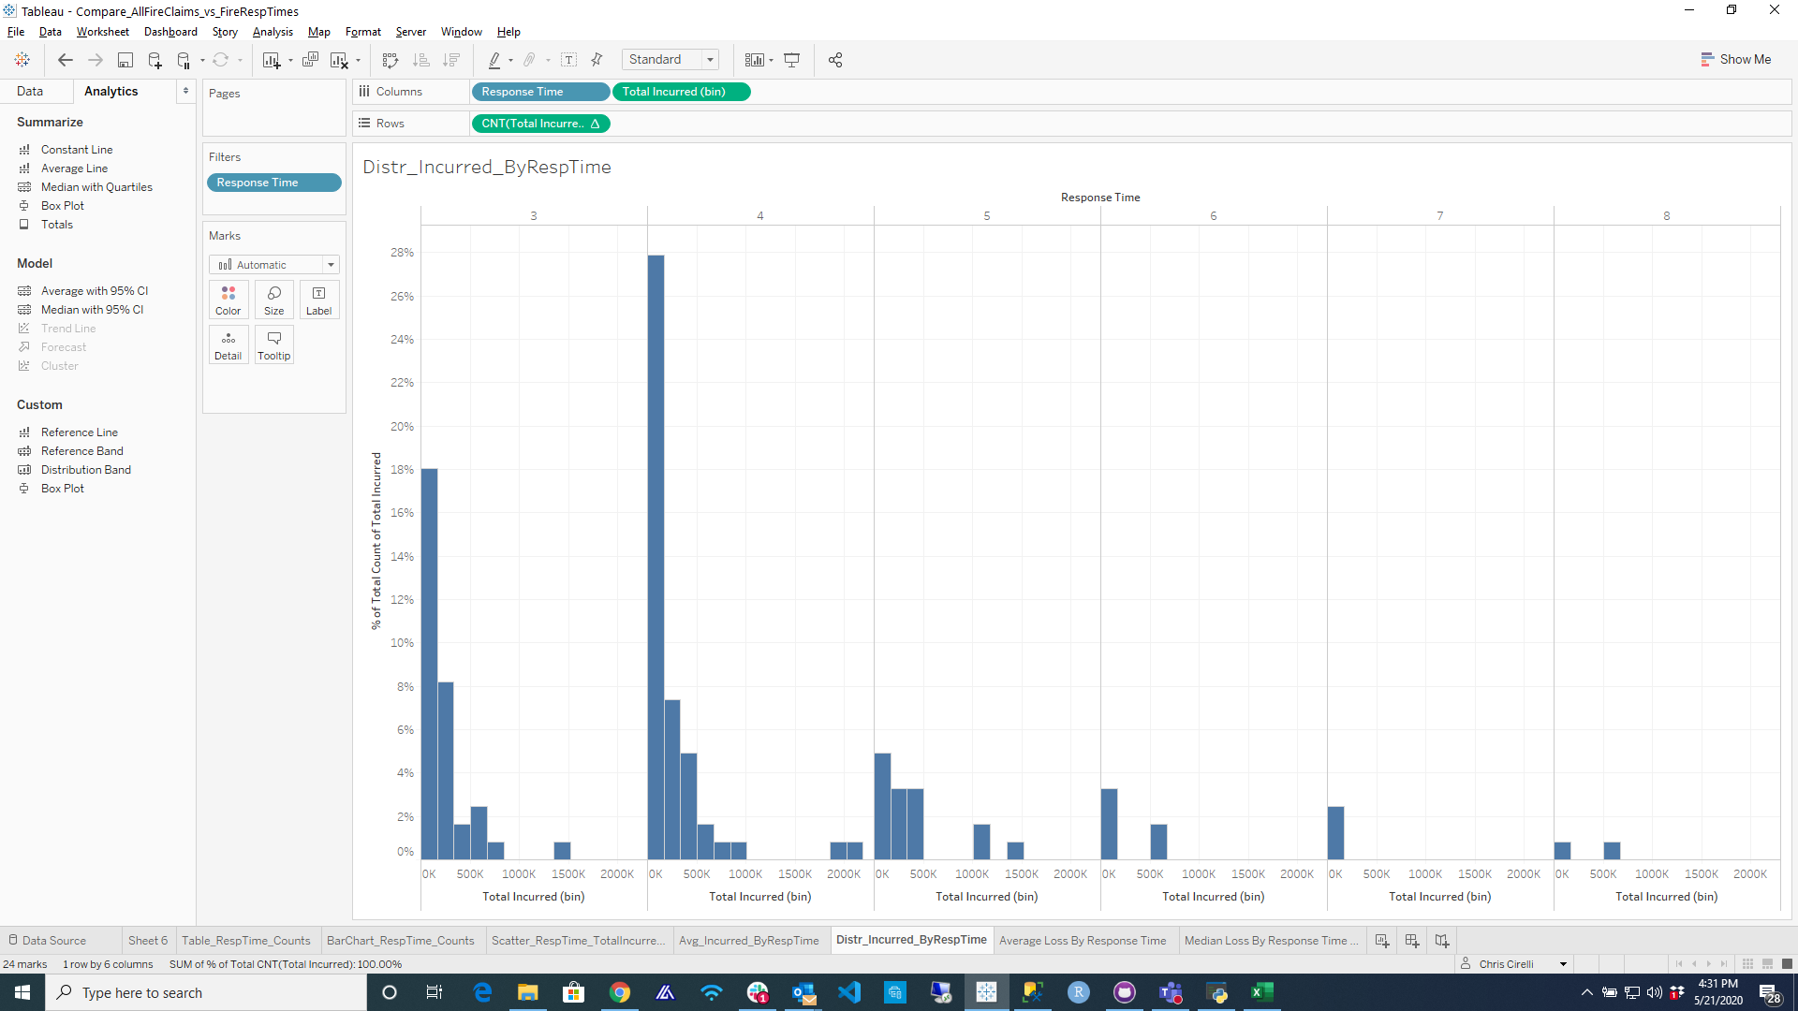
Incurred Loss
Distribution by Response Times
Purpose
To understand the distribution of incurred losses by fire score.
Visualizations
The first chart shows the average losses incurred per response time bin.
The second shows the distribution of losses by response time.
Observations
An argument could be made that there is a positive correlation between average incurred losses and response times.
That being said, and if the present concern losses that can exceed $3.5m, the bottom chart suggest that there is an inverse relationship in which the largest historical losses have occured in lowest response times.
Largest losses have occured in lower response time bins

Slide 12
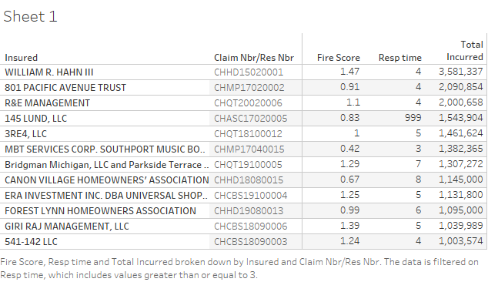
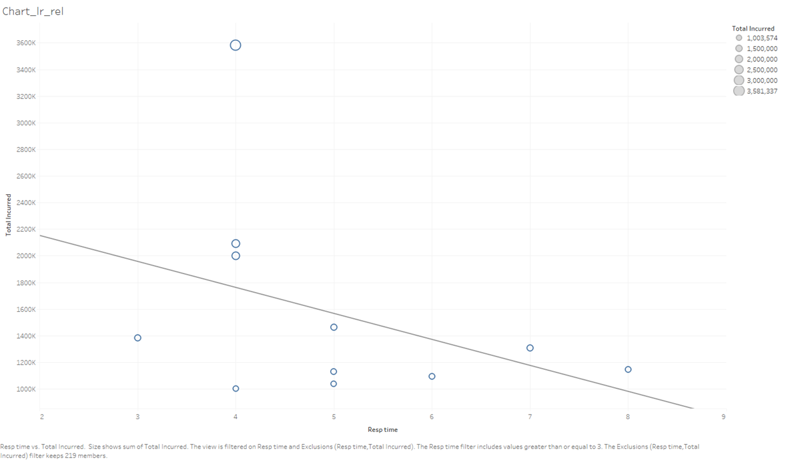
Fire Response Times
Top 10 Losses
Purpose
To understand the relationship between the fire response time and largest incurred fire losses.
Visualizations
*The first table represents incurred fire losses in excess of $1m.
The second visualization is the distribution of fire losses by response time. The horizontal line represents a regression line fit to the data.
Observations
There appears to be a negative correlation between fire loss severity and response times.
Conclusion
There are likely other factors (size, type, building materials, location, etc.) unaccounted for here that influence the severity of a fire loss.
*The fire response time of 999 is a default value for when the model is unable to calculate a value.

Slide 13
ABC utilizes the Fire Response Times for risk selection

Slide 14
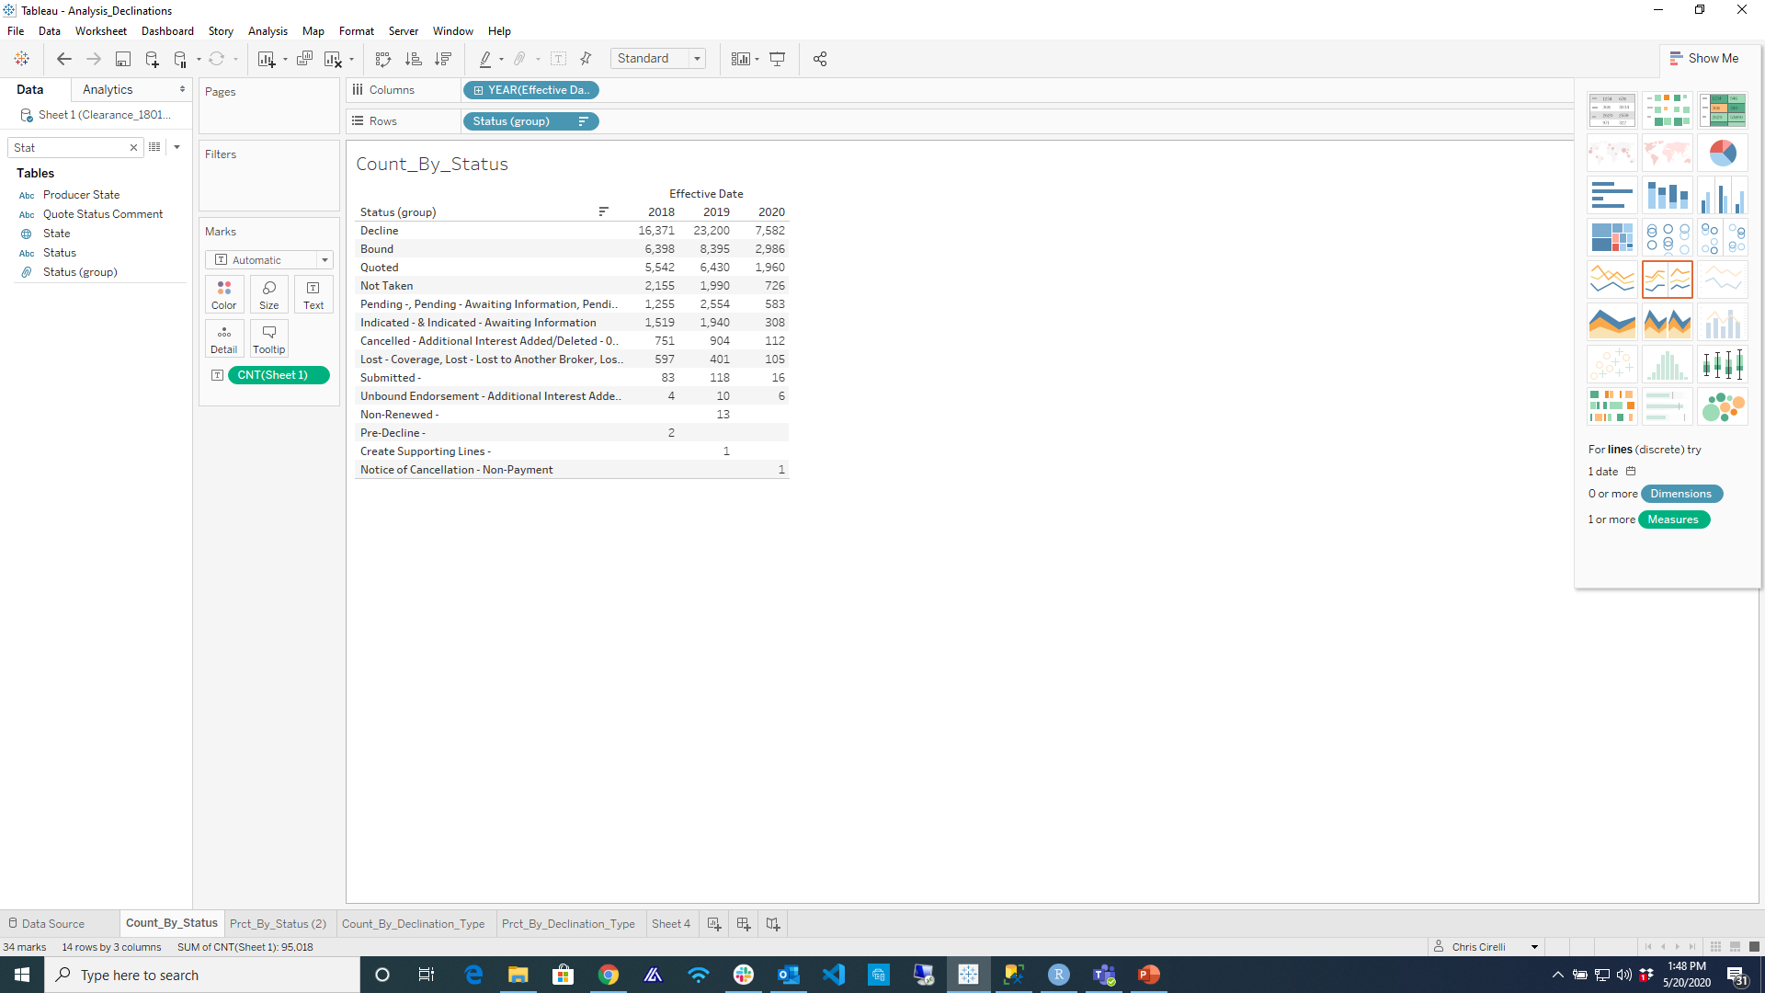
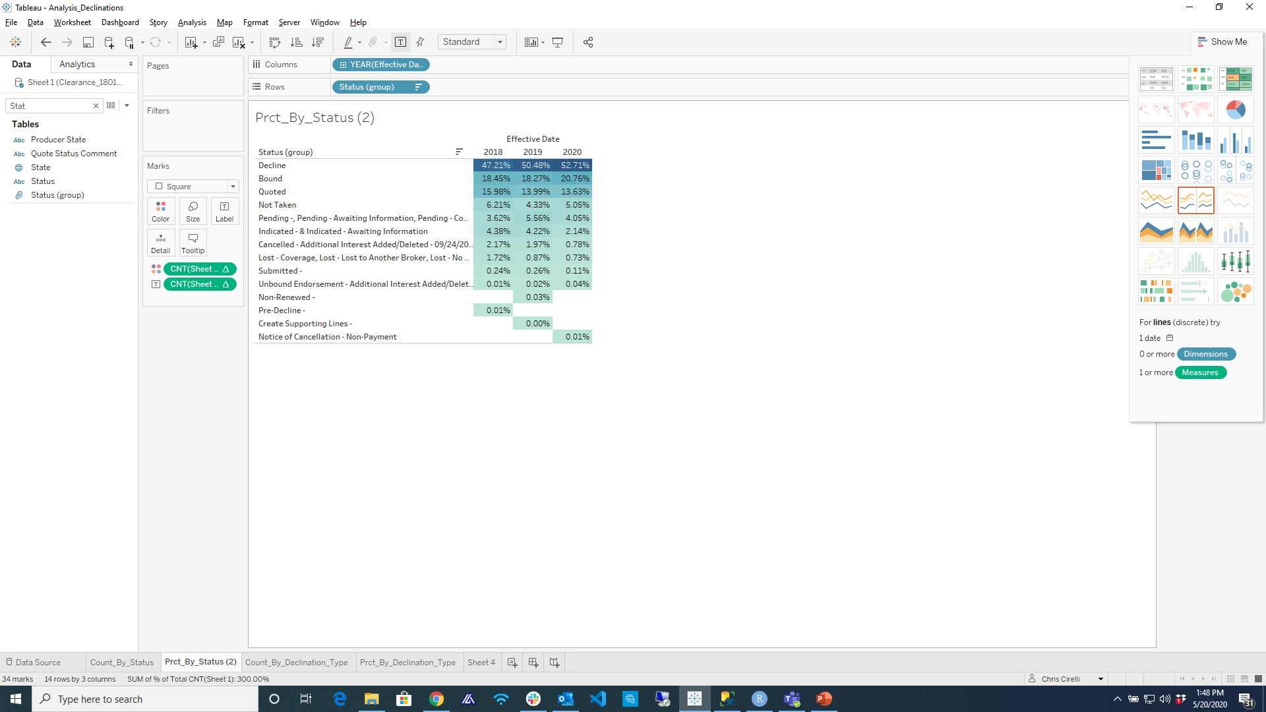
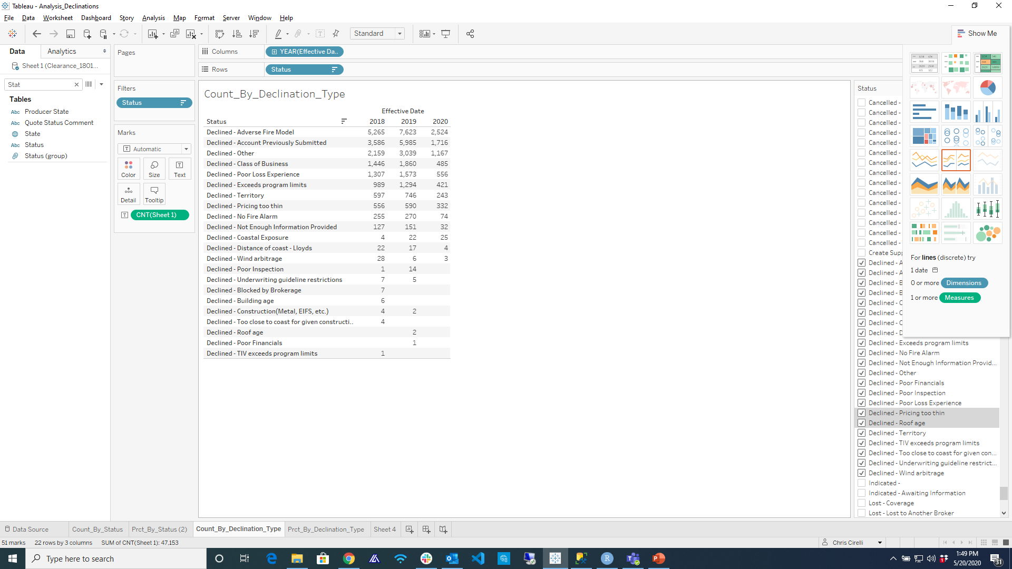
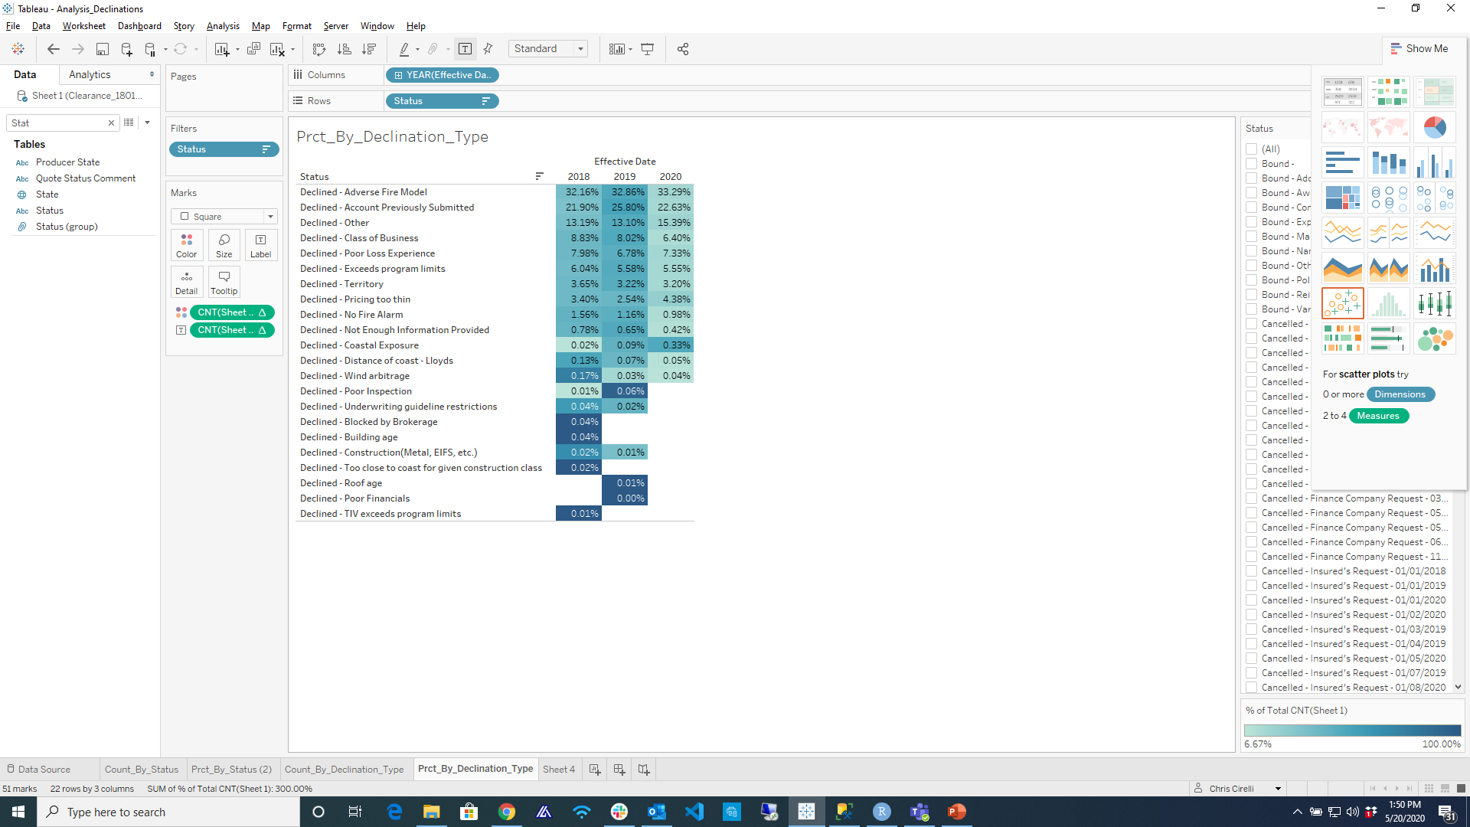
Risk Selection
Declination Analysis
Purpose
*To understand the extent to which ABC Insurance underwriters utilize the Fire Response Time as a risk selection tool.
Visualizations
The tables at the top represent the count and percentage of submissions by status category.
The tables at the bottom represent the count and percentage of submissions by declination status.
Observations
Over 50% of submissions are declined of which roughly 32% is due to adverse.
Based on the percentage of declinations due to fire it is safe to assume that fire response times are utilized by underwriters as a risk selection tool.
*It is not clear if “Declined - Adverse Fire Model” refers exclusively to the fire response time, fire response index or a combination of the two.

Slide 15
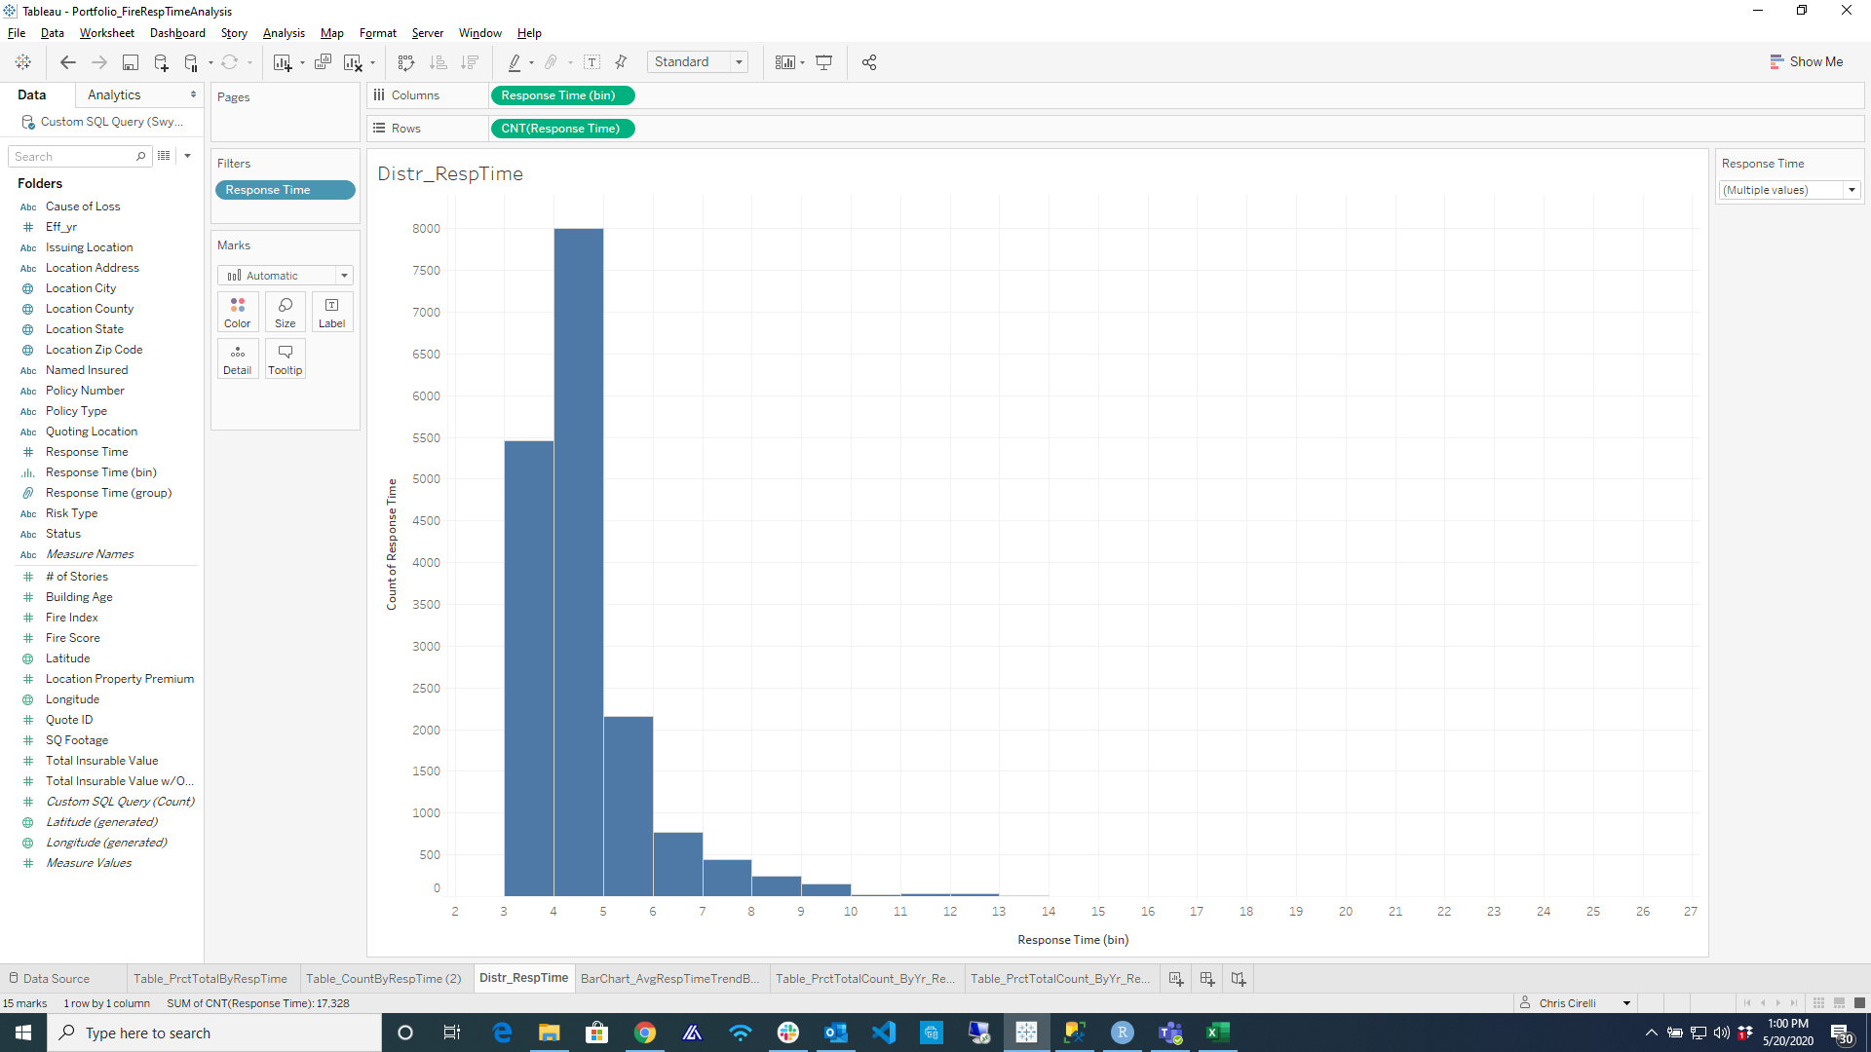
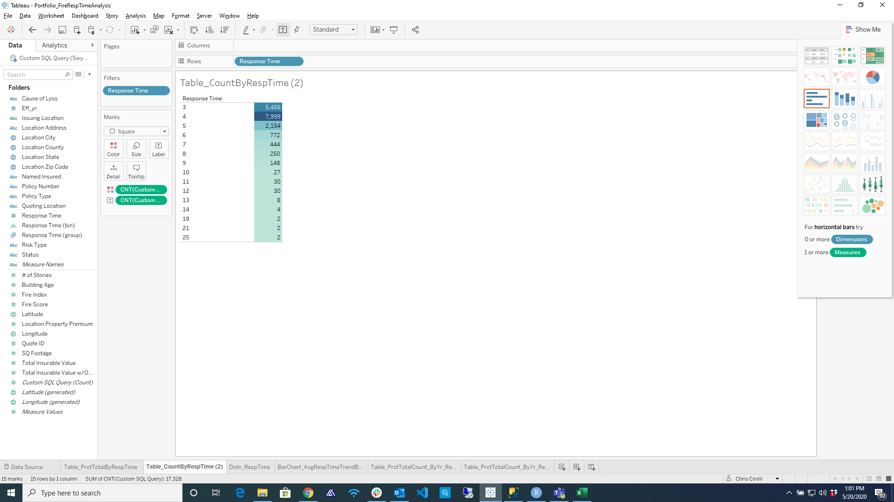
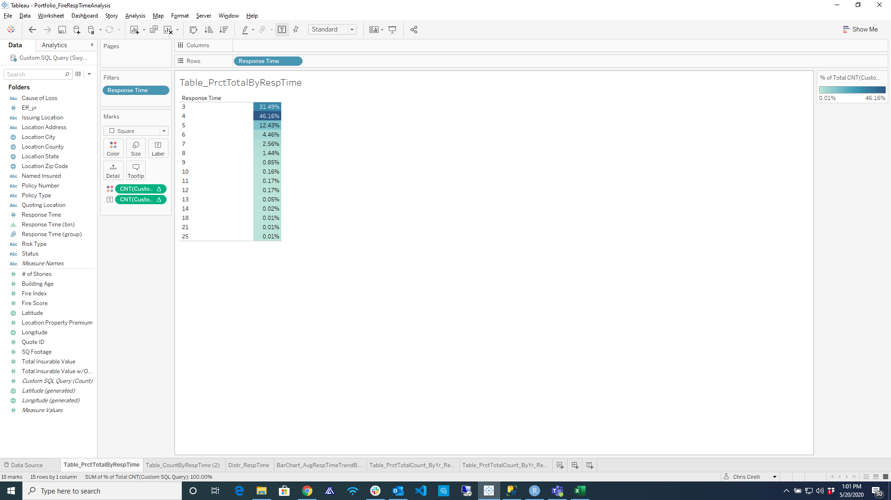
Fire Response Times
Core Portfolio
Purpose
To understand the distribution of fire response times for the Core portfolio.
Visualizations
The top chart represents the distribution of Fire Response Times for the Core portfolio for all years.
The tables at the bottom represent the count and percentage of policies by response time.
Observations
Fire response times follow a type of gamma distribution.
The majority (77%) of observations fall into response times of 3-4 seconds.

Slide 16
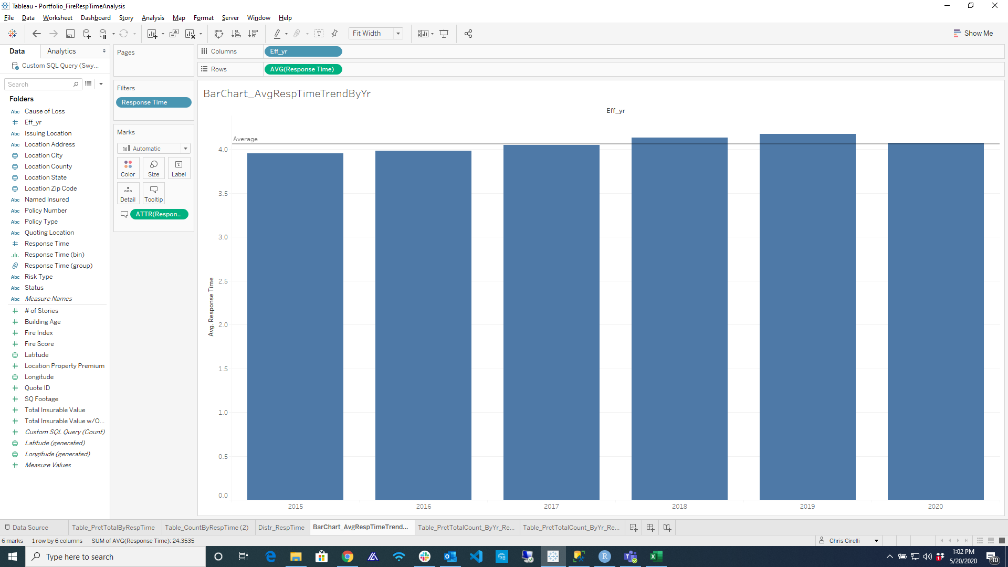
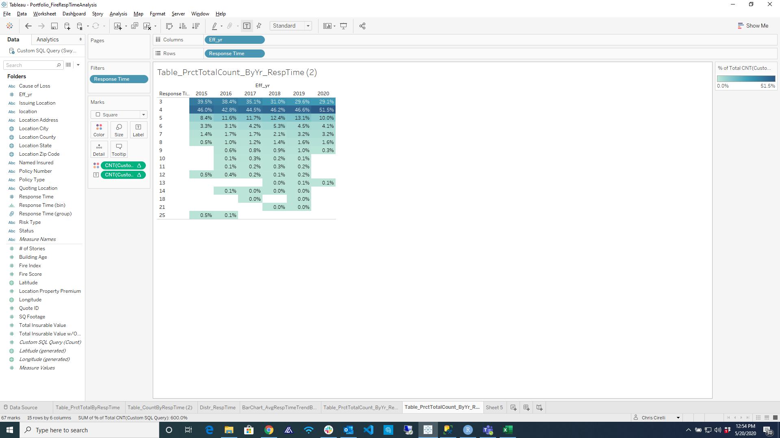
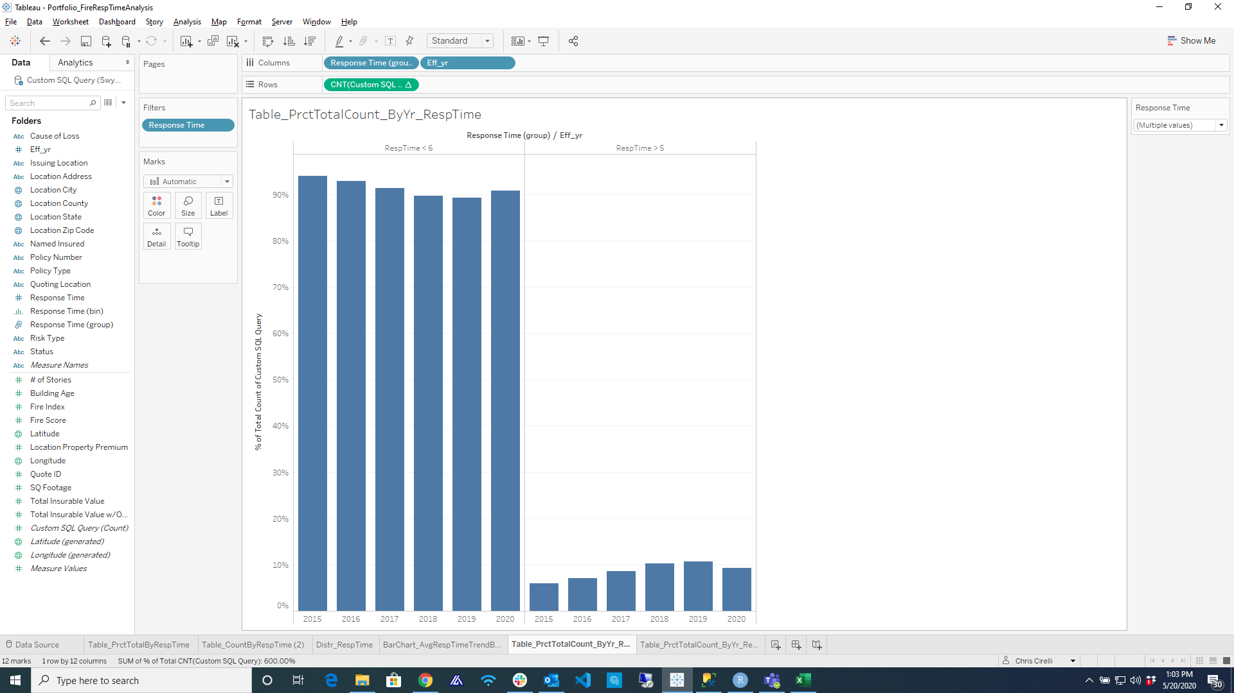
Fire Response Times
ABC Portfolio Over Time
Purpose
To understand how the composition of response times for the ABC portfolio have developed over time.
Visualizations
The top graph represents the average response time from years 2015 to 2020.
The bottom left table represents the distribution of response times by year.
The bottom right graph represents the percentage of accounts with responses less than 6 and greater than 5 by year.
Observations
The average response time has trended upward between 2016 and 2019.
In particular, response times for 5-8 seconds have trended upward while 3-4 seconds have trended downward.
By bifurcating response times at 6 seconds we more clearly this trend.
Conclusion
Fire response times are being used as a risk selection tool, yet the average response time of the portfolio has trended upward over time.

Slide 17
ABC’s Portfolio is better than the overall market in terms of Fire Response Scores

Slide 18
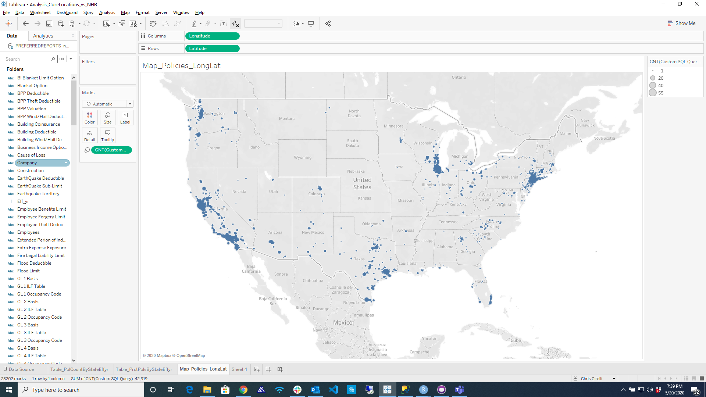
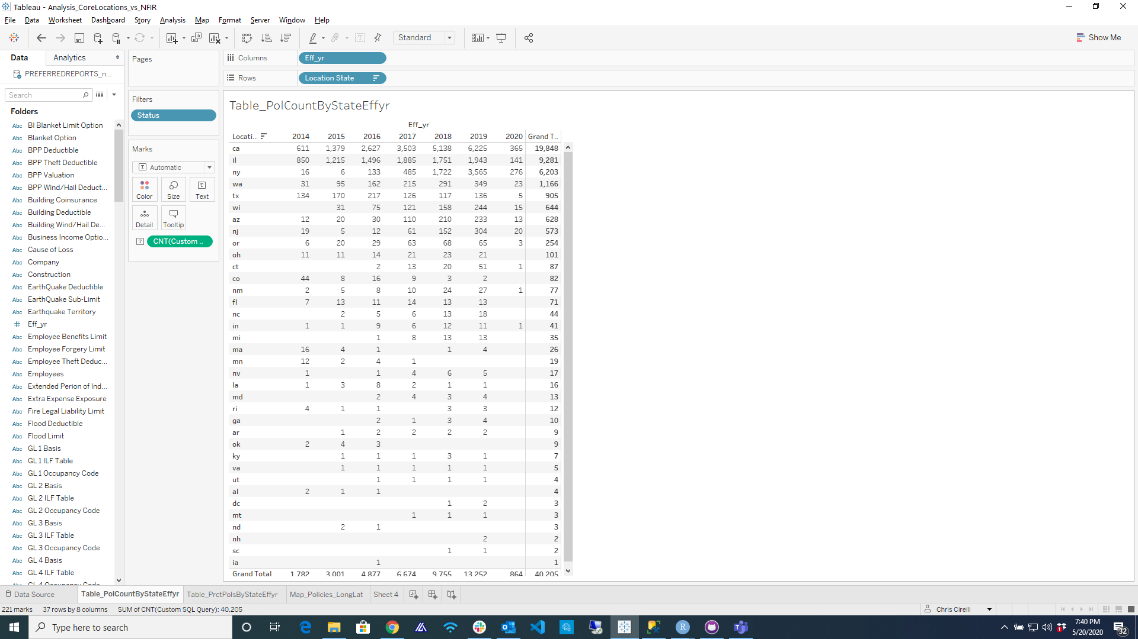

Fire Response Times
ABC’s Portfolio by Geography
Purpose
To understand the composition of ABC’s portfolio by geography.
Data
All historical bound policies.
40,205 observations
Visualizations
The top visualization illustrates the geographical location of ABC’s bound policies.
The bottom tables represent the count and percentage of total by bound policies.
Observations
CA, IL and NY constitute the majority (85%) of all policies.

Slide 19
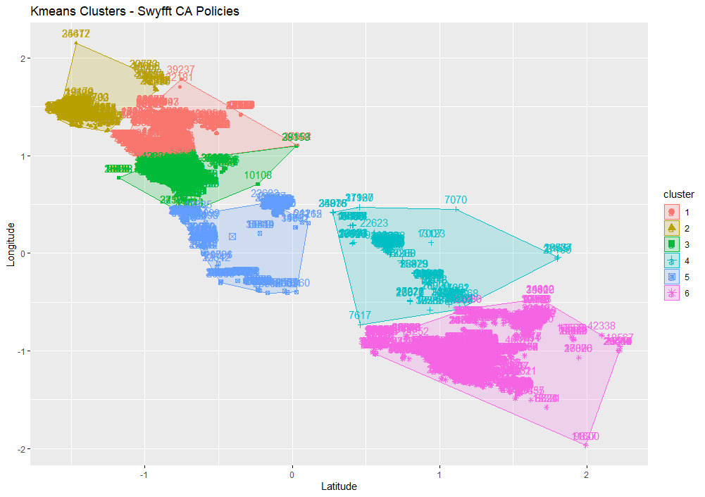
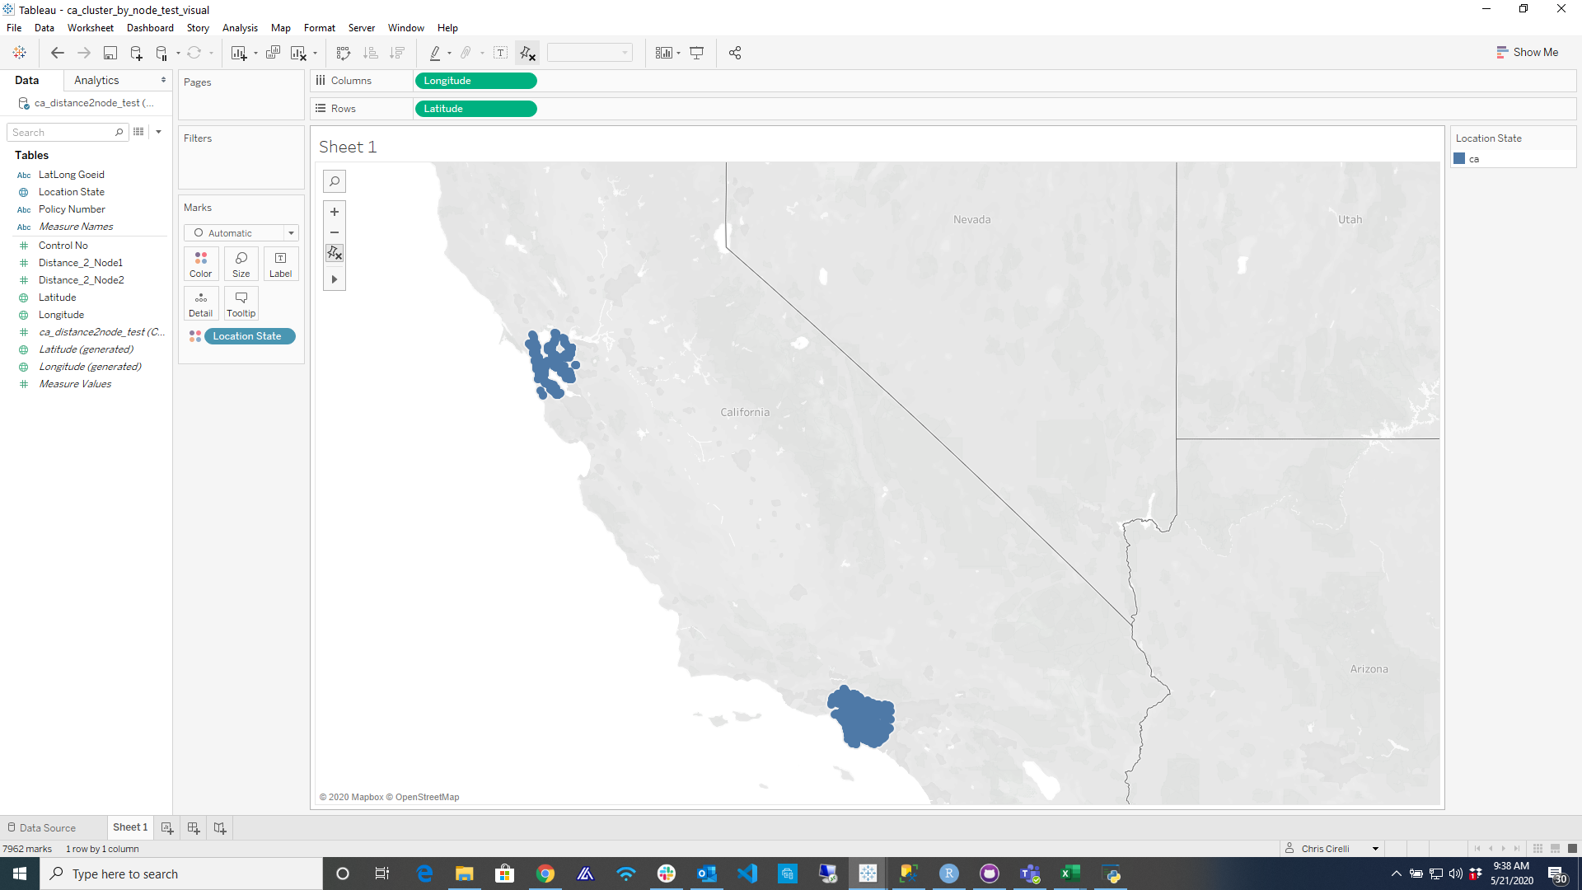
ABC Policies
Identifying geographical clusters (CA)
Purpose
To identify clusters of policies based on their geographical location.
Approach
Utilize Kmeans clustering algorithm to derive the optimal location of centroids/nodes for policy clusters.
Visualizations
The top illustration is a plot of the 6 clusters that were fit to the latitude and longitude coordinates for all historical policies.
The second illustration is a plot of the policies that reside within 24 miles of the nodes of the two largest clusters.
Observations
For the most part the geolocation of ABC’s policies are highly concentrated.
Two clusters (3 & 6) in particular comprise over 85% of all observations.
Cluster Latitude Longitude size
3 34.06189 -118.3294 9890
6 37.81131 -122.2723 7873
1 33.92765 -117.6918 1071
2 32.83178 -117.0910 485
5 34.78968 -119.5253 255
4 36.96039 -120.0223 194
Cluster 3
Cluster 6
Notes:
NFIR Inciden Response Type
Structural Fire: 111 to 118
Property Type
Residential: 419, 429, 439, 449, 459, 460, 464, 400

Slide 20
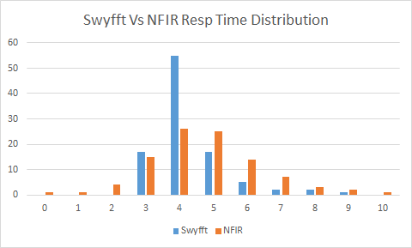
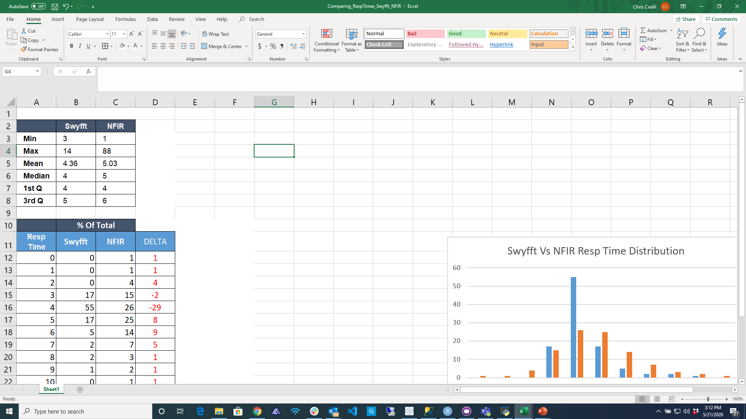
ABC Response Times
Versus NFIR
ABC
Purpose
To compare the distribution of response times for similarly located observations from the ABC and NFIR datasets.
Visualizations
The graph at the top represents the percentage distribution of observations by response time.
The table at the bottom represents a comparison of measures of central tendency.
Observations
While both the ABC and NFIR distributions have a bell shaped curve, the Kurtosis (peak) is materially different.
For instance, both the ABC and NFIR datasets have similar mean and median measures of central tendency, yet over 50% of the ABC portfolio has response times of 4 versus less than 30% for NFIR.
In addition, the fatness of the tails for the NFIR dataset are more pronounced in terms of the higher response times versus that of the ABC dataset.
Conclusion
The distribution of ABC fire scores does exhibit a pronounced difference when compared to the NFIR dataset for comparable geographical locations.
Difference
Prct. Total Observations
ABC
ABC

Slide 21
ABC’s portfolio has exhibited a low probability of incurring a severity loss > $3.5m.

Slide 22
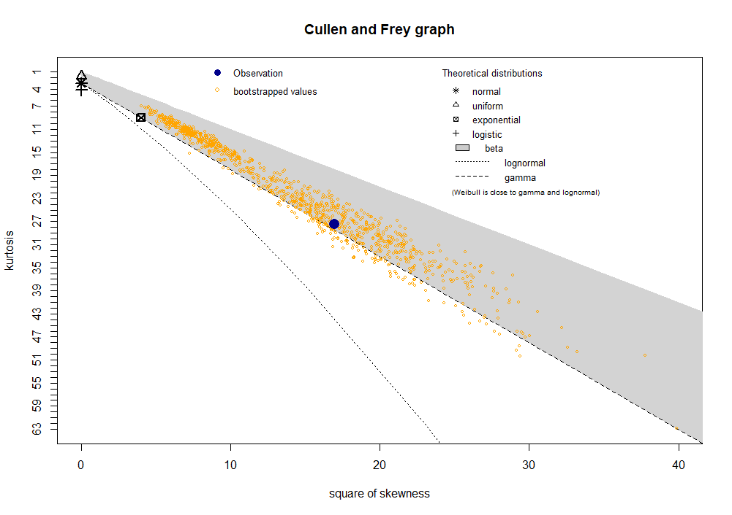
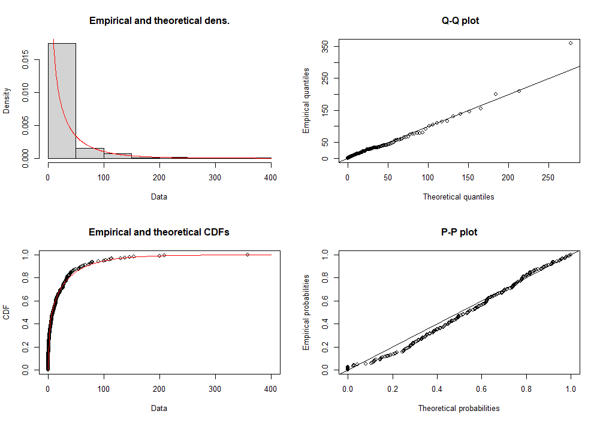
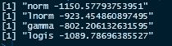
Fitting a Probability Dist.
Fire Losses
Purpose
Fit a theoretical distribution to the historical total incurred fire losses.
Visualizations
The Cullen and Frey Graph compares the skewness and kurtosis of the observed distribution to other well known distributions.
The bottom visualizations represent various measures of goodness of fit of a theoretical gamma distribution versus the observed distribution.
Observations
Both the Cullen Frey Graph and measures of goodness of fit indicate the distribution of fire losses follows a gamma/exponential distribution.
The log likelihood values for competing distributions support the argument that this is a gamma/exponential distribution.
Gamma distribution fit to observed data.

Slide 23
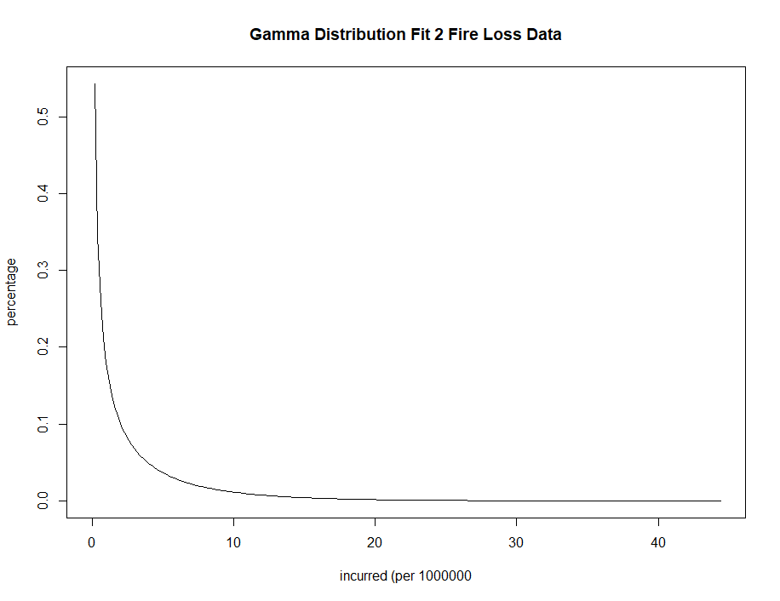
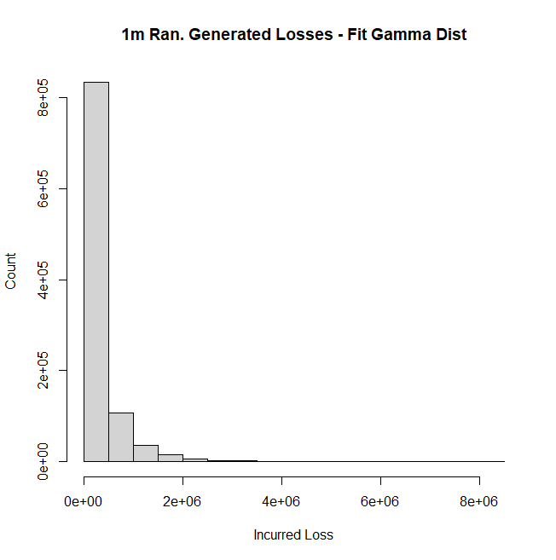
Fit Gamma Distr.
Likelihood of Severity Loss
Purpose
Fit a gamma distribution to the fire loss data in order to calculate the likelihood of incurring a loss in excess of $3.5m.
Generate 1m random losses from fit gamma distribution to calculate number of losses > $3.5m
Visualizations
The first plot is the probability distribution fit to the loss data.
The second is a discrete distribution derived from generating 1m losses from the same gamma distr.
Loss Probabilities
P < 100k 51%
P < 500k 83%
P < 1m 94%
P < 3.5m 99.92%
Randomly Generated Losses
1st Qu. $13,763 - Median $90,136
Mean $259,611 - Max $9,337,957
Cnt > 3.5m 802 - Prob > 3.5m .07%
Observations
The gamma distribution fits very well to our historical loss data.
Based on historical loss data there is roughly a 0.08% (or 802 per 1m chance) of incurring a loss > $3.5m.

Slide 24
Concluding Remarks

Slide 25
Concluding Remarks
Historical loss data suggests that ABC’s portfolio exhibits a very low probabiliby (<1%) of incurring a fire loss in excess of $3.5m.
A comparison of fire response scores between the ABC portfolio and that of NFIR’s for comparable locations in CA supports the argument that ABC’s portfolio has better response times than the market.
A review of declination data supports the argument that ABC underwriters are using fire response scores as a risk selection tool. That being said, the book is trending on average toward higher fire response times.
There does not appear to be a positive correlation between fire response times and fire loss severity. There are likely other factors (size, type, building materials, location, etc.) unaccounted for in this study that influence the severity of a fire loss.
A review of the distribution of all loss perils supports the argument that fire is likely the only loss peril that could give rise to a loss in excess of 3.5m. That said, there is some evidence to suggest that hail could give rise to a loss at least as high as this amount.

